Slide 1
ORPHANAGE MANAGEMENT SYSTEM
SOFTWARE ENGINEERING
Under the guidance of
Dr Sheikh Fahad Ahmad Sir

Slide 2

TEAM MEMBERS
ROLL NUMBER
NAME
2110030087
P.SRAVYA
2110030088
T.NIHARIKA
2110030165
B.LAHARI
2110030178
CH.JAYASREE

Slide 3


WHAT IS ORPHANAGE MANAGEMENT SYSTEM

Slide 4
PROBLEM STATEMENT
An orphanage is a place where children without parents' care.
The orphanage management system manages the records, planning, and budgeting for the children in the orphanages.
Integrity, transparency, and accountability on these records become a major issue if the records are altered.
There are also circumstances where children are lost and then accommodated in the orphanages.

Slide 5
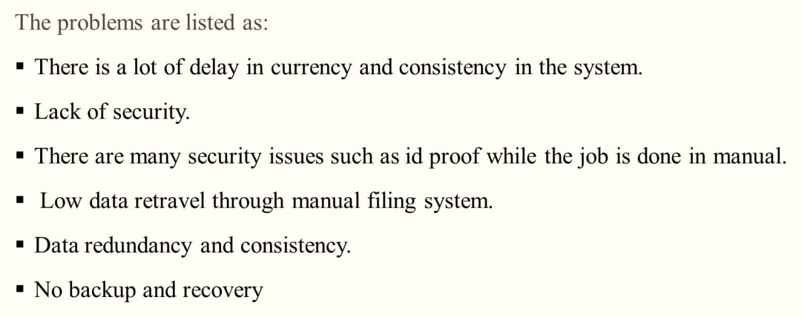
PROBLEMS IN PRESENT EXISTING SYSTEM

Slide 6
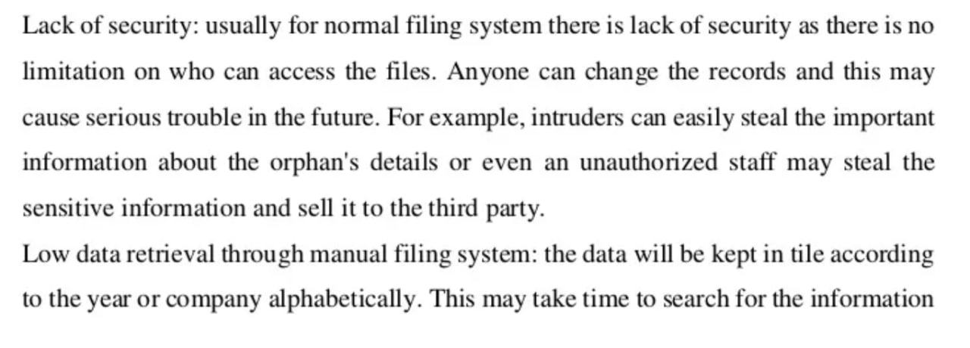
PROOFS SUPPORTING THE PROBLEMS IN EXISTING SYSTEM

Slide 7
https://ijisrt.com/wp-content/uploads/2019/03/IJISRT19FB200.pdf
ANALYSIS OF EXISTING SYSTEM:
House of hope is a fast-growing orphanage, which uses a manual method of storing information about orphans i.e., the use of paper and files in keeping the record of all orphans. This method is quite tedious and prone to error because manual system depends absolutely on human effort. The orphanage home currently lacks space for physical data storage due to the increasing number of orphans coming to the orphanage home due to the crisis in Jos. They are finding it difficult to manage the large amount of paperwork. The manual system takes longer time to generate report, also maintaining the system is quite expensive.

Slide 8
PROPOSED ALGORITHM
As Orphanages are increasing day to basis simultaneously the helping hands are also increasing in the higher range.
The practical difficulty is finding out the real orphans and less knowledge about the donation details.
So we are developing an Application to help to reach the needy orphans by volunteer donations.
It allows the users to search and find the orphanages on the internet and then they can donate to the orphanages whichever they want.
Motive of our paper is to eliminate the drawback of the previous application and to help orphans to the full extent.

Slide 9

LITERATURE REVIEW
Orphanage Management System is software which is helpful for Service people as well as the admin authorities.
In the current system all the activities are done manually.
It is very time consuming and costly. Our Orphanage Management System deals with the various activities related to the orphanage.
Achieving this objective is difficult using a manual system as the information is scattered, can be redundant and collecting relevant information may be very time consuming.
The Orphanage and Donation Management System project aims at satisfying the requirements of needy organizations through donations over the net.
The application shall ask the user/donor to register his/her details into the system and then he/she can login and put-up items to donate.
Similarly, organizations can register in the system and then put up their item requirements. Also, a donor can view the list of items put up by seekers and can donate the same, if possible.

Slide 10
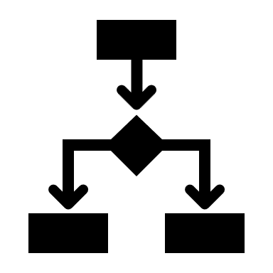
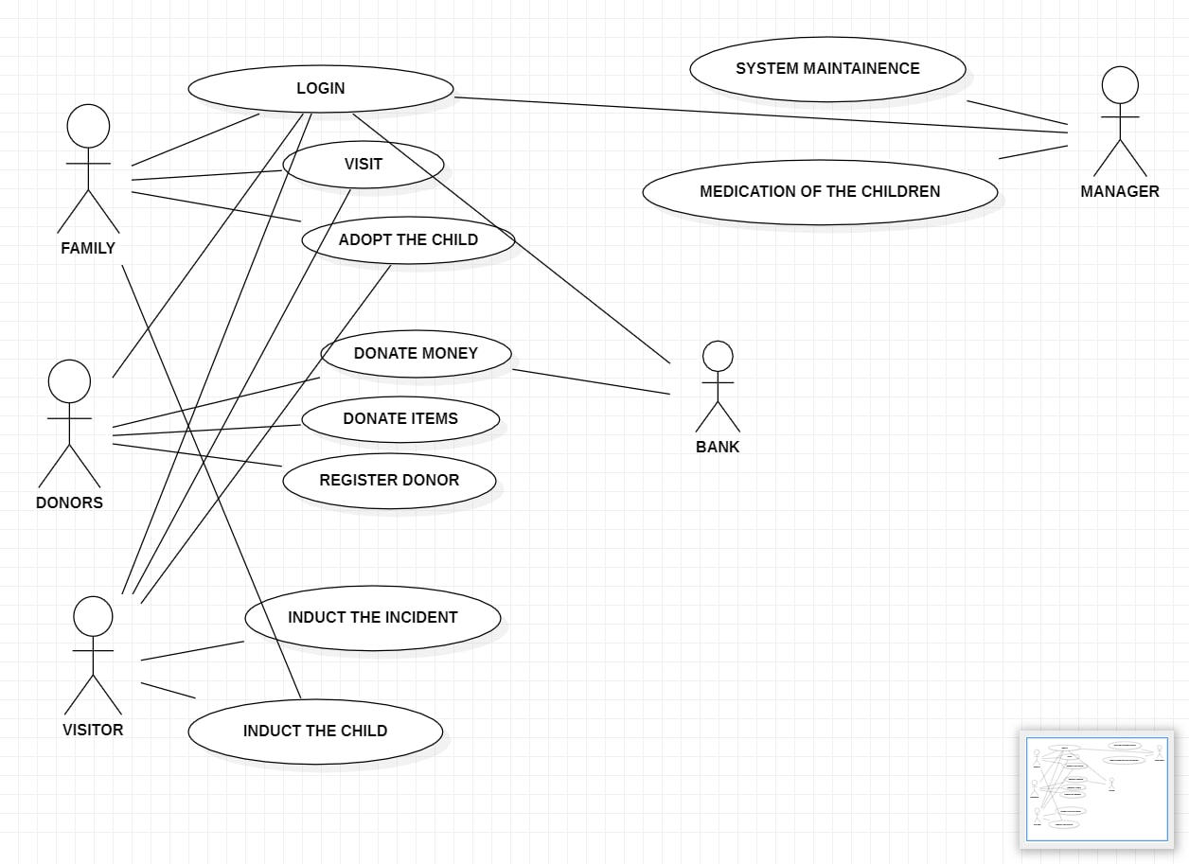
DESIGN MODELLING DIAGRAMS

Slide 11
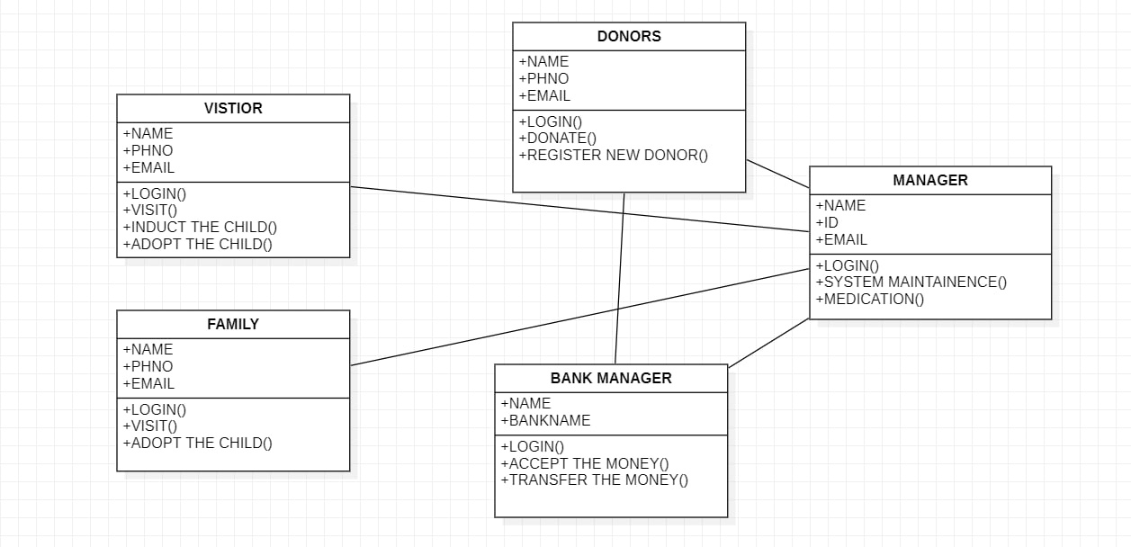
DESIGN MODELLING DIAGRAMS

Slide 12

PROJECT REQUIREMENTS
USER REQUIREMENTS:
TIME SAVING.
SECURED APPLICATION.
EASILY ACCESABLE AND MANAGEABLE.
ACCURATE INFORMATION TO BE MAINTAINED.
SYSTEM REQUIREMENTS:
OPERATING SYSTEM: WINDOWS7 AND ABOVE.
FRONT-END : PYTHON.
RDBMS : MySQL

Slide 13

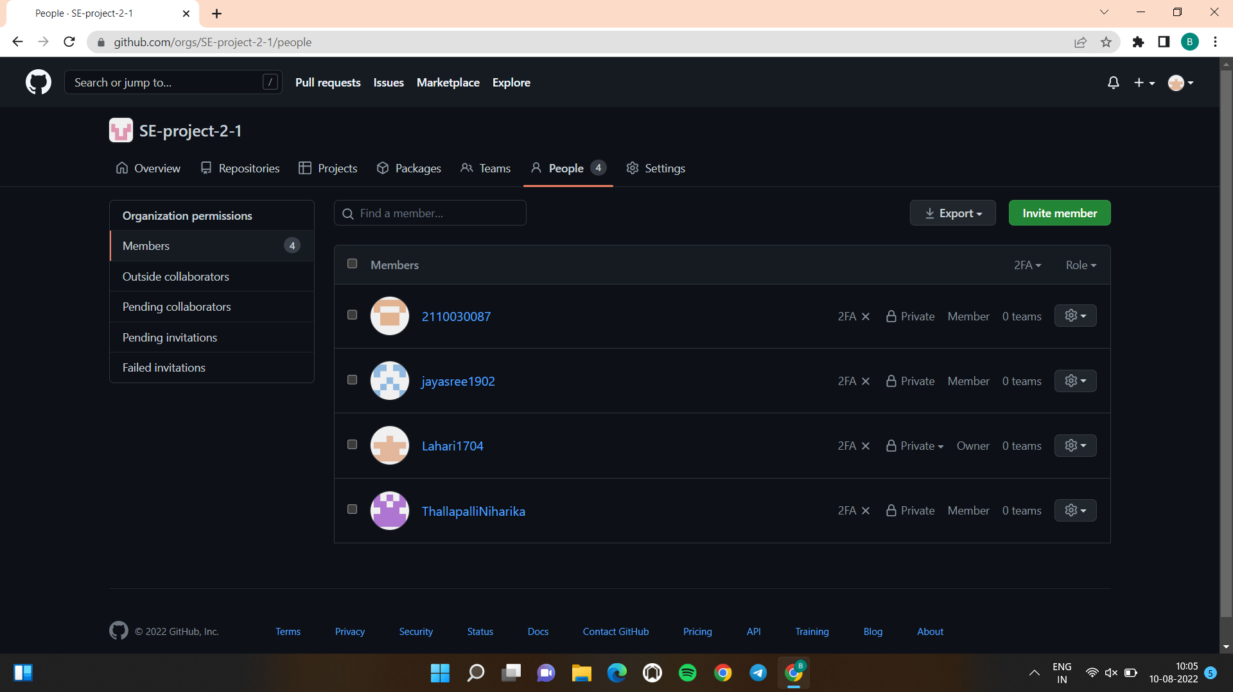
GITHUB SETUP
https://github.com/ThallapalliNiharika
https://github.com/Lahari1704
https://github.com/jayasree1902
https://github.com/2110030087

Slide 14

DATA SET COLLECTION
ORPHAN’S DATA COUNT
ORPHAN’S DETAILS (EDUCATION,MEDICAL,PERSNAL)
LOCATION(ADDRESS OF ORPHANAGES).
MANAGEMENT DETAILS.(MANAGER NAME,PHONE NUMBER).
BANK MANAGEMENT DETAILS AND LINKED ACCOUNTS(FOR DONATIONS).
INTERVIEWS
SURVEYS
RESEARCH AND PROBLEMS.

Slide 15

TOOLS REQUIRED
UML
MY SQL
WEB SERVERS
FRAMEWORKS
SURVEYS
FLOWCHARTS

Slide 16

REFERENCES
https://codeshoppy.com/shop/product/orphanage-management-system/
https://www.researchgate.net/publication/355107033_in_Digitalized_Orphanage_Home_Management_System_Consisting_of_Mass_Data_Entries_DIGITALIZED_ORPHANAGE_HOME_MANAGEMENT_SYSTEM_CONSISTING_OF_MASS_DATA_ENTRIES
https://en.wikipedia.org/wiki/Use_case_diagram
https://www.researchgate.net/publication/328225350_Design_and_Development_of_an_Orphans_Record_System

Slide 17

WORK ALLOCATION
S.NO | ROLL.NO | NAME | WORK ALLOCATION
1. | 2110030088 | T.NIHARIKA | RESEARCH AND SURVEYS
2. | 2110030087 | P.SRAVYA | DESIGN MODELLING DIAGRAMS
3. | 2110030178 | CH.SAI JAYASREE | RESEARCH AND PPT
4. | 2110030165 | B.LAHARI | SRS DOCUMENT

Slide 18
THANK YOU

